Slide 1
TOP 100 DOMINATING INFLUENCERS IN 2025
SUBMITTED BY,
PRAJITH.M
DATA ANALYTIC
TECHOLAS TECHNOLOGIES

Slide 2
INTRODUCTION
Social media has become a central part of modern communication. Platforms like Instagram, YouTube, Twitter, and TikTok dominate this space. The top 100 accounts on these platforms represent global influence. These accounts shape trends, audience behavior, and digital culture. Analyzing their success reveals key engagement strategies. We explore metrics like followers, reach, and content performance. This data helps understand what drives social media growth. From celebrities to brands, each account has unique strengths. This presentation uncovers patterns and actionable insights. Join us in exploring the world of social media's top influencers.

Slide 3
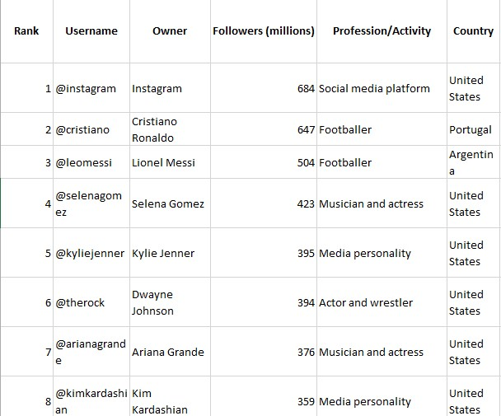
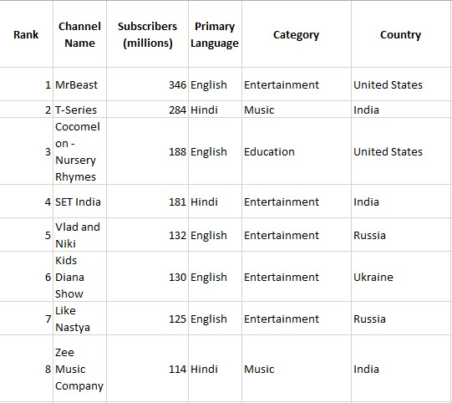
DATASET
INSTAGRAM
YOUTUBE

Slide 4
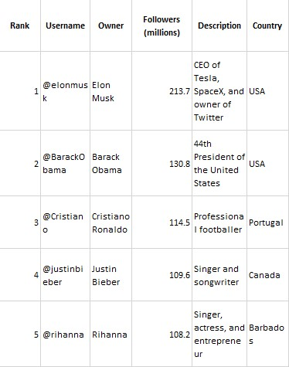
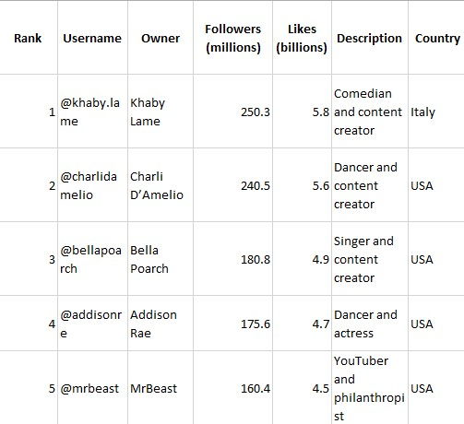
DATASET
TWITTER
TIKTOK

Slide 5
KEY DETAILS
Instagram
Top Account: @instagram (684 million followers)
Most Followed Individual: Cristiano Ronaldo (@cristiano, 647 million followers)
Notable Professions: Includes footballers, musicians, and media personalities.
Dominant Countries: United States, Portugal, and Argentina.
YouTube
Top Channel: MrBeast (346 million subscribers)
Second Place: T-Series (284 million subscribers, Hindi-language content)
Popular Categories: Entertainment, music, and education.
Dominant Countries: United States, India, and Russia.

Slide 6
KEY DETAILS
Twitter
Most Followed: Elon Musk (@elonmusk, 213.7 million followers)
Second Place: Barack Obama (@BarackObama, 130.8 million followers)
Notable Fields: Business, politics, sports, and music.
Dominant Country: United States.
TikTok
Top Creator: Khaby Lame (@khaby.lame, 250.3 million followers, 5.8 billion likes)
Second Place: Charli D’Amelio (@charlidamelio, 240.5 million followers)
Popular Genres: Comedy, dance, and content creation.
Dominant Countries: Italy and United States.

Slide 7
CRITIRIA USED
MAX Of Subscribers(millions) By Country
- Stacked Bar
COUNT Of Followers(millions) By Country
– Line Chart
SUM Of Followers(millions) By Description
- Ribbon Char t
AVERAGE Of Likes(billions) By Owner
– Stacked Chart
MIN Of Followers (millions) And MIN Of Subscribers(millions) – Donut chart
Country – Slicer
Owner – Slicer
Rank – Slicer

Slide 8
CRITIRIA USED
AVERAGE Of Likes(billions)
- Gauge
SUM Of Followers(millions)
- Gauge
Followers(millions) AVERAGE Per Likes(billions)
- Card
MIN Of Subscribers(millions) - Card

Slide 9
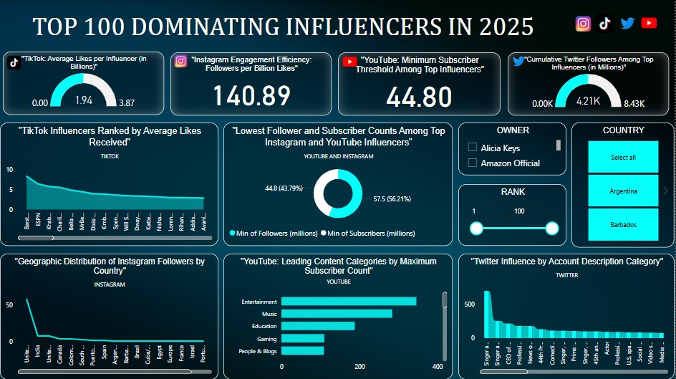
DASHBOARD

Slide 10
CONCLUSION
Social media platforms are dominated by influential figures and organizations across various industries, reflecting their diverse appeal and global reach. On Instagram, celebrities like Cristiano Ronaldo and Lionel Messi lead with massive followings, emphasizing the platform's focus on sports and entertainment. YouTube showcases the power of content creation, with MrBeast and T-Series topping the charts in entertainment and music categories. Twitter highlights a mix of tech entrepreneurs, politicians, and entertainers, with Elon Musk and Barack Obama as prominent figures, reflecting its role as a platform for influence and discourse. TikTok, known for its viral short-form content, is led by creators like Khaby Lame and Charli D’Amelio, demonstrating the rise of individual content creators in shaping digital culture. Together, these platforms illustrate the evolving landscape of social media and its impact on global communication and entertainment.

Slide 11
THANK YOU

